Slide 1

B18 Lesson 8
Bishop Stopford School
faith | justice | responsibility | truth | compassion
ONLINE LEARNING
Learning Objectives
Retrieval
Acquire
Action
Review
Dig Deeper

Slide 2
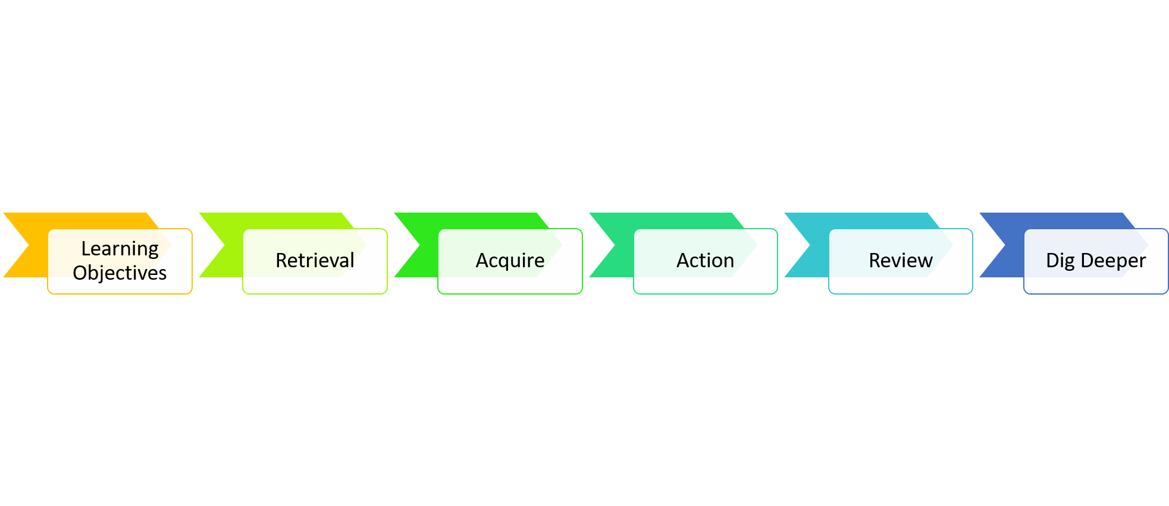
B18 Consolidation and Revision Lesson
Learning Objectives
1) Consolidate and revise the content of chapter B18

Slide 3
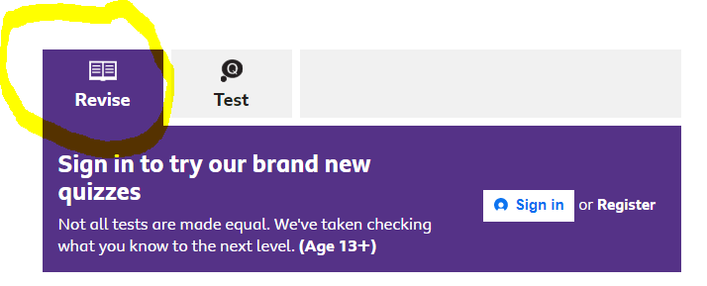
Starter: Retrieval Quiz
Complete the BBC bite size quizzes
https://www.bbc.co.uk/bitesize/guides/zt8f4qt/test
https://www.bbc.co.uk/bitesize/guides/zs7gw6f/test
https://www.bbc.co.uk/bitesize/guides/ztwvk2p/test
Once you have done each quiz this you can switch to the revise tab to go over the questions you were unsure of / got wrong

Slide 4

Listen to the revision podcast
https://bishopstopford.fireflycloud.net/science-2/school-closure-tasks/year-10-1/biology/triple/b18-revision-and-assessment/b18-revision
Note: If you cant get the podcast to work it can also be found on the Kerboodle website.
You can listen to this as many times as you want to

Slide 5
Kerboodle Assessment
Due 7th June
Your teachers will be checking that this work has been completed
Complete the end of chapter Kerboodle 'Checkpoint Quiz' assessment. This will have been set by your teacher
https://www.kerboodle.com/app
2) Complete your Kerboodle reflection (WWW/EBI/MRI) in your book. Remember to record the score you got out in your book too!
I have put an example of what a good Kerboodle reflection looks like on the next slide

Slide 6
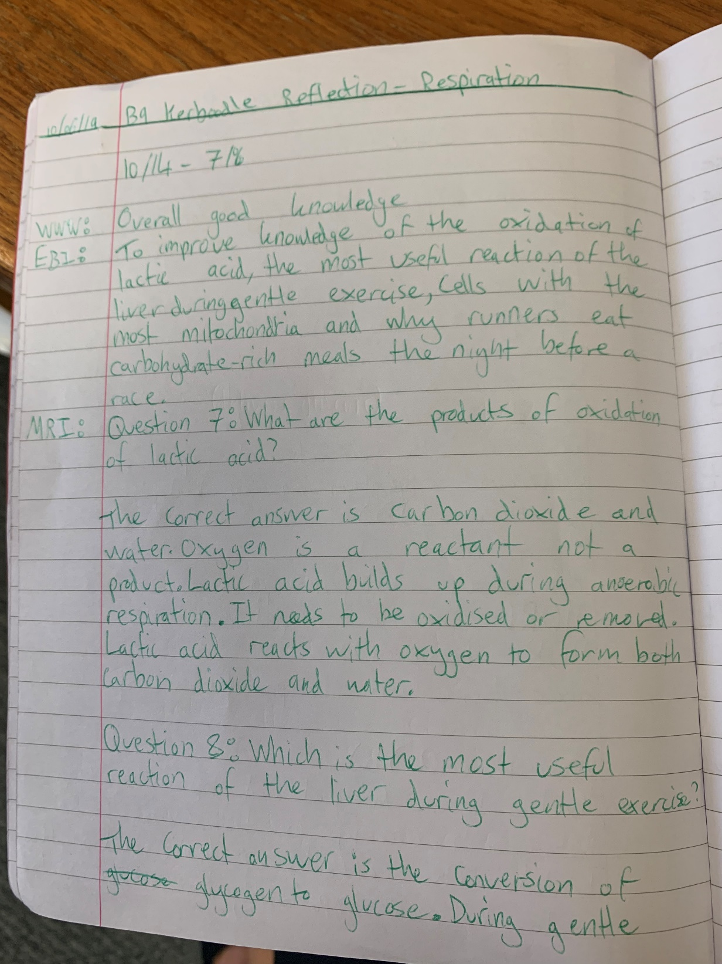
Example Kerboodle reflection

Slide 7
Dig deeper (optional)
We have now finished chapter 18. One of the themes running through the chapter are the issues associated with the growing human population. Research and answer the following extension questions.
1) What is the human population estimated to be when you are 30 years old?
2) Why might it not be as is currently predicted?
3) How do you think your life will be different then as a result ?

